Slide 1
DATABASE MANAGEMENT SYSTEM
Relational Database Model

Slide 2
Objectives
2
To understand relational model for the representation of data
To explain the characteristics of a relational table
To cover examples of relational schema and relational diagram
To understand the types of keys used in relational model
To go over the types of integrity rules needed for a good database design

Slide 3
Logical View of Data
3
Allows focus on logical representation of data and its relationship rather than physical storage details.
Facilitated by the creation of data relationships based on a logical construct known as “relation”.
Word “relation” is based on the mathematical set theory from which Codd derived his model and called it so.
A relation represents a two-dimensional table composed of rows and columns.
A table contains a group of related entity occurrences, that is, an entity set. Example: STUDENT table contains collection of entity occurrences, each represent a student.
Relation = Entity Set = Table = Dataset (in MS Access)

Slide 4
Characteristics of a Relational Table
4
1 | A table is perceived as a two-dimensional structure composed of rows and columns.
2 | Each table row (tuple) represents a single entity occurrence within the entity set.
3 | Each table column represents an attribute, and each column has a distinct name.
4 | Each row/column intersection represents a single data value.
5 | All values in a column must conform to the same data format.
6 | Each column has a specific range of values known as the attribute domain.
7 | The order of the rows and columns is immaterial to the DBMS.
8 | Each table must have an attribute or a combination of attributes that uniquely identifies each row.

Slide 5
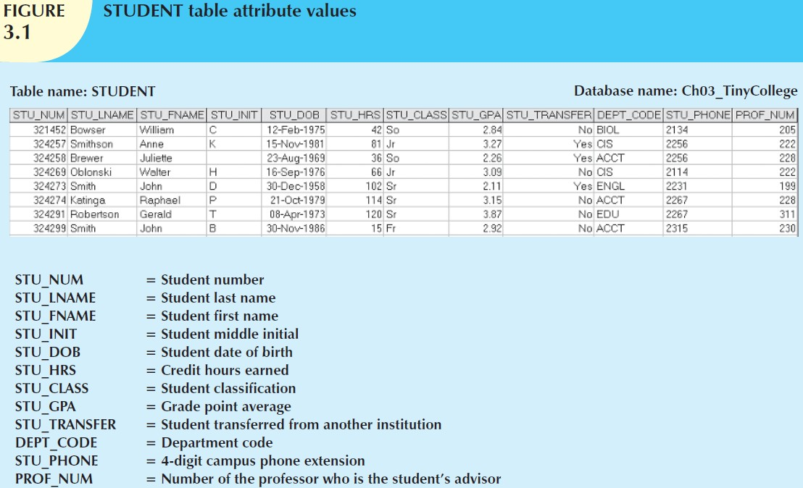
Relational Table Example
5

Slide 6
Keys
6
Primary key (PK) is an attribute (or a combination of attributes) that uniquely identifies any given row. Example: STU_NUM
Each table must have a primary key
A key consists of one or more attribute that determine other attributes. Example: invoice number identifies all invoice attributes.
Key’s role is based on a concept known as determination, which is, if you know the value of attribute A, you can look up (determine) the value of attribute B. (A → B)
The statement “STU_NUM determines STU_LNAME” can be written as: STU_NUM → STU_LNAME
In fact, the STU_NUM determines all of the student’s attributes:
STU_NUM → STU_LNAME, STU_FNAME, STU_INIT, STU_DOB, STU_TRANSFER

Slide 7
Keys (contd.)
7
The principle of determination is used in the definition of a central relational database concept known as functional dependency.
The attribute B is functionally dependent on the attribute A if each value of column A determines one and only one value in column B. Example: STU_PHONE is functionally dependent on STU_NUM.
On the other hand, STU_NUM is not functionally dependent on STU_PHONE. (Two students could be roommates and share phone)
Composite key is a key that is composed of more than one attribute.
Any attribute that is part of a key is known as a key attribute.
If attribute B is functionally dependent on a composite key A but not on any subset of that composite key, the attribute B is fully functionally dependent on A.
For example, it is very likely that:
STU_LNAME, STU_FNAME, STU_INIT, STU_PHONE → STU_HRS, STU_CLASS
but NOT: STU_LNAME, STU_FNAME → STU_HRS, STU_CLASS

Slide 8
Keys (contd.)
8
A superkey is any key that uniquely identifies each row.
(The superkey functionally determines all of a row’s attributes) For example the superkey could be any of the following: STU_NUM
STU_NUM, STU_LNAME STU_NUM, STU_LNAME, STU_INIT
A candidate key can be described as a superkey without
unnecessary attributes (a minimal superkey)
STU_NUM, STU_LNAME is a superkey but NOT a candidate key
STU_NUM is a superkey and also a candidate key
If student’s Social Security number (or NIC) had been included in STUDENT table, named STU_SSN, it could also be a candidate key.
In short, the primary key (PK) is the candidate key chosen to be the unique row identifier.

Slide 9
Null
9
A null is no value at all.
A null is not same as zero or a space. (zero and space are values)
A null is created when you press the Enter key or Tab key to move to next entry without giving any value.
(pressing the Spacebar creates a blank or a space)
Null can never be part of a primary key.
Nulls should be avoided in other attributes too. There could be exceptions, for example: STU_INIT
If used improperly, a null can create problems because it could be:
An unknown attribute value.
A known, but missing, attribute value.
A “not applicable” condition.
Nulls can create problems with functions like COUNT, AVERAGE, SUM and when relational tables are linked.

Slide 10
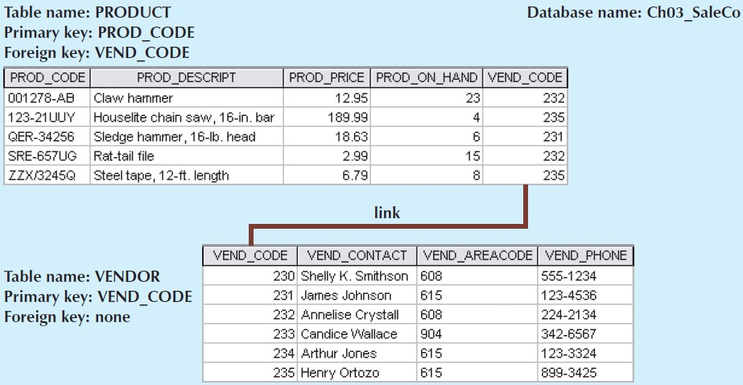
Controlled Redundancy
10
Controlled redundancy makes the relational database work.
Tables within DB share common attributes enabling linking together.

Slide 11
Relational Schema
11
Relational database can also be represented by a relational schema
A relational schema is a textual representation of the database tables where each table is listed by its name followed by the list of its attributes in parentheses. The primary key attributes underlined.
Example:
VENDOR (VEND_CODE, VEND_CONTACT, VEND_AREACODE, VEND_PHONE)
PRODUCT (PROD_CODE, PROD_DESCRIPT, PROD_PRICE, PROD_ON_HAND, VEND_CODE)
The link between the PRODUCT and VENDOR tables can also be represented by the relational diagram

Slide 12
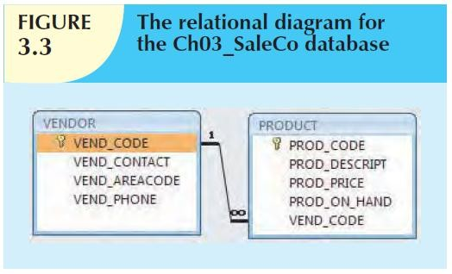
Relational Diagram
12
The link is created when two tables share an attribute with common values.
The primary key of one table (VENDOR) appears as the foreign key in a related table (PRODUCT).
A foreign key (FK) is an attribute whose values match the primary key values in the related table.
A secondary key is defined as a key that is used strictly for data retrieval purposes. It does not necessarily yield a unique outcome. For example, a customer’s phone number could easily yield several matches where one family lives together and share a phone number.

Slide 13

Relational Database Keys (Review)
13
KEY TYPE | DEFINITION
Super key | An attribute (or combination of attributes) that uniquely identifies each row in a table.
Candidate key | A minimal (irreducible) Superkey. A single attribute Superkey is itself a Candidate Key.
Primary key | A candidate key selected to uniquely identify each row in a table. Cannot contain null entries.
Secondary key | An attribute (or combination of attributes) used strictly for data retrieval purposes. Does not necessarily yield a unique outcome.
Foreign key | An attribute (or combination of attributes) in one table whose values must either match the primary key in another table or be null.

Slide 14

Integrity Rules
14
Relational database integrity rules are very important for a good database design.
Many RDBMSs enforce integrity rules automatically. However, it is much safer to make sure that your application design conforms to the entity and referential integrity rules.
ENTITY INTEGRITY | DESCRIPTION
Requirement | All primary key entries are unique, and no part of a primary key may be null.
Purpose | Each row will have a unique identity, and foreign key values can properly reference primary key values.
Example | No invoice can have a duplicate number, nor can it be null. In short, all invoices are uniquely identified by their invoice number.

Slide 15

Integrity Rules (contd.)
15
REFERENTIAL INTEGRITY | DESCRIPTION
Requirement | A foreign key may have either a null entry, as long as it is not a part of its table’s primary key, or an entry that matches the primary key value in a table to which it is related. (Every non-null foreign key value must reference an existing primary key value.)
Purpose | It is possible for an attribute NOT to have a corresponding value, but it will be impossible to have an invalid entry. The enforcement of the referential integrity rule makes it impossible to delete a row in one table whose primary key has mandatory matching foreign key values in another table.
Example | A customer might not yet have an assigned sales representative (number), but it will be impossible to have an invalid sales representative (number).

Slide 16
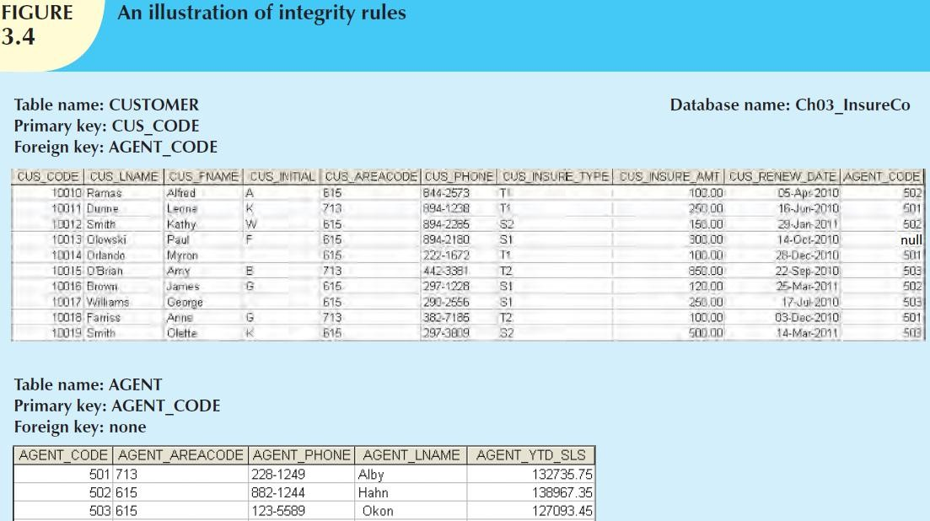
Integrity Rules (contd.)
16

Slide 17

Integrity Rules (contd.)
17
To avoid nulls, some designers use special codes, known as
flags, to indicate the absence of some value.
Using Figure 3.4 as an example, the code -99 could be used as the AGENT_CODE entry of the fourth row of the CUSTOMER table to indicate that customer Paul Olowski does not yet have an agent assigned to him.
If such a flag is used, the AGENT table must contain a dummy row with an AGENT_CODE value of -99.

Slide 18
Integrity Rules (contd.)
18
Other integrity rules that can be enforced in the relational model are the NOT NULL and UNIQUE constraints.
The NOT NULL constraint can be placed on a column to ensure that every row in the table has a value for that column.
The UNIQUE constraint is a restriction placed on a column to ensure that no duplicate values exist for that column.

Slide 19
Conclusion
19
In this Lecture, we…
Understood the relational model as the logical representation of data
Explained the characteristics of a relational table
Covered examples of relational schema and relational diagram
Understood the types of keys used in relational model
Covered the types of integrity rules used in relational model that are needed for a good database design

